Slide 1
Early American Societies
Amerinds
Mesoamerica
South America

Slide 2
Amerinds
American Indians
Migration
Geography and Farming
Early Societies
  Urbanization
  Caral,North-Central Peru
    150-acre complex
    Economy
    Society

Slide 3
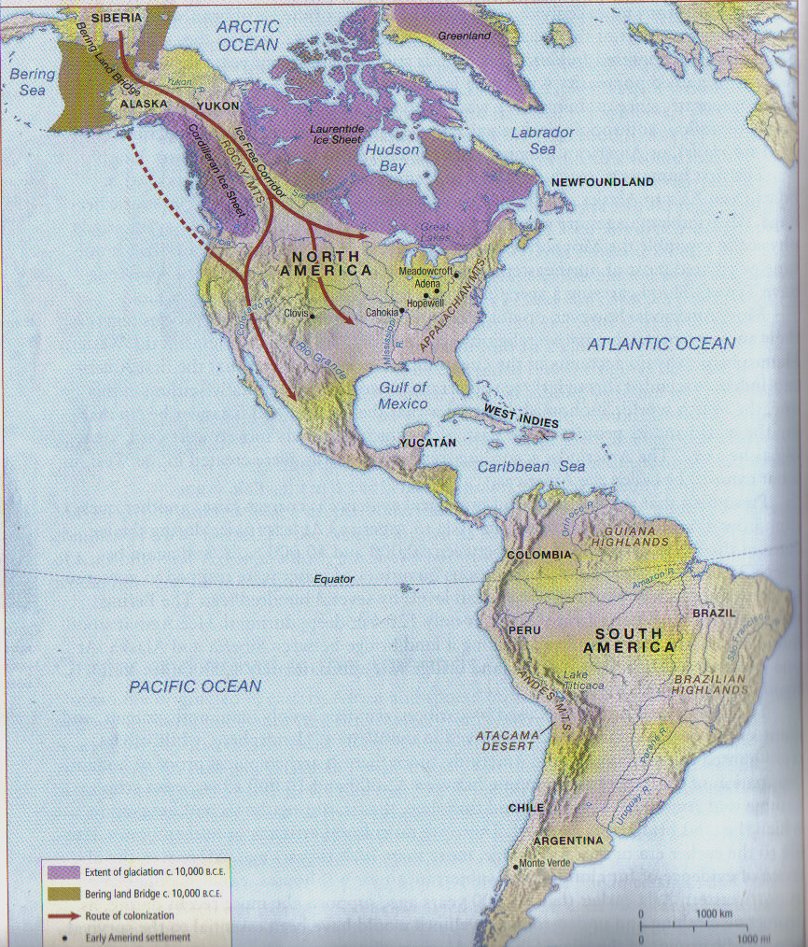

Slide 4
Mesoamerica
Olmecs, 1800 B.C.E.
  Urban society
  La Venta
  Commerce
    Imported basalt, obsidian, and iron ore.
Maya
  Village-based agriculture
    Maize
  Society and Politics
  Religion
    Popul Vuh
    Long Count Calendar
Teotihuacan
  “City of the Gods”
  North-South Grid axis
  Pyramid of the Sun

Slide 5
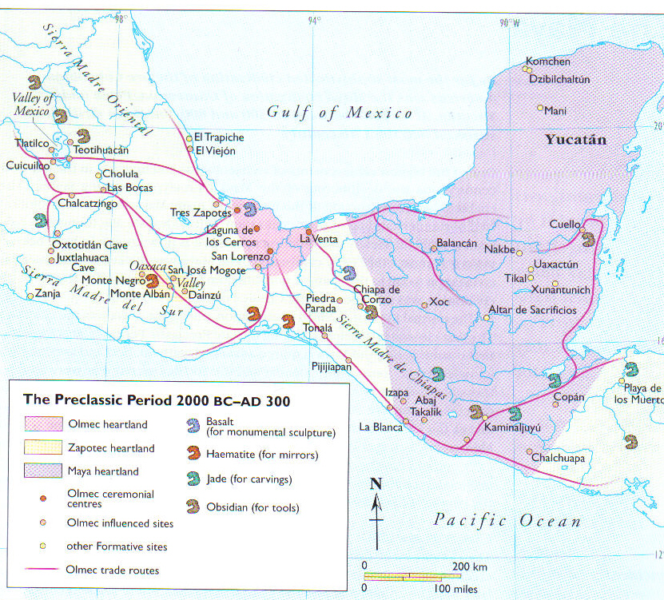

Slide 6
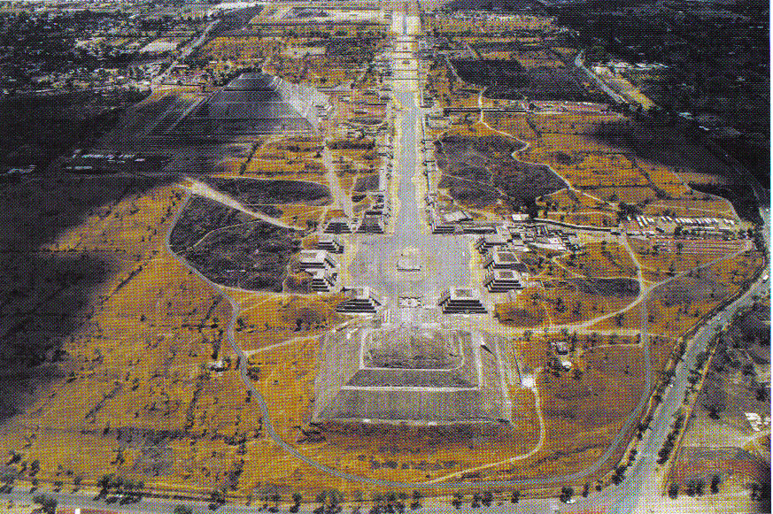
Pyramid of the Sun

Slide 7
South America
Andes Mountains
  “Ring of Fire”
Cities
  Chavín 1800 B.C.E.
    City complex
    Intricate art, jewelry and textile economy.
    “Smiling God”
  Moche
    Art as the definer of history.
  Chimor
    First Andean Empire

Slide 8
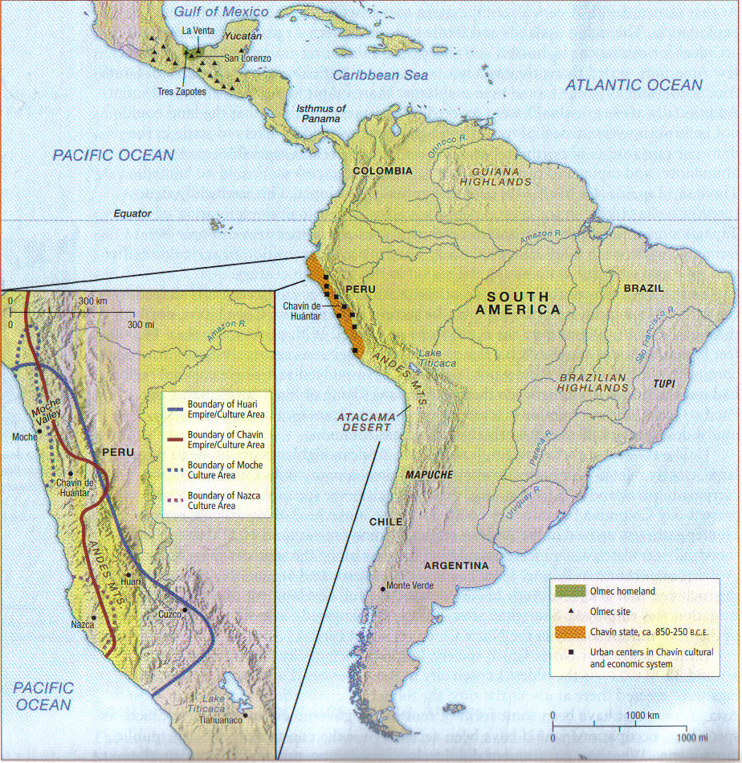

Slide 9
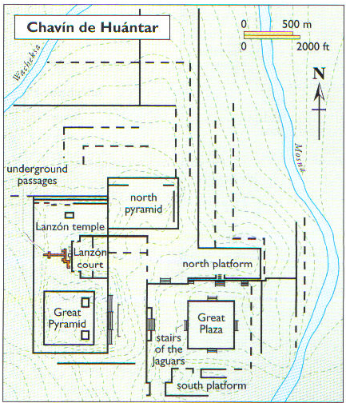

Slide 10
